Slide 1
VOLUME 2
CHAPTER 2:PREVENTION OF CATHETER ASSOCIATED URINARY TRACT INFECTIONS (CAUTI)
PREVENTION OF COMMON HCAI’S

Slide 2
Chapter Outline
Chapter Contents
PPP 1.1:Over view
PPP 1.2: Epidemiology and mechanism of CAUTI
PPP 1.3: Risk factors of CAUTI
PPP 1.4: Pathogens associated with CAUTI
PPP 1.4:Quality improvement for prevention of CAUTI
PPP 1.5: Summary

Slide 3
Learning objectives
By the end of this chapter, participants will be able to:
Define catheter associated urinary tract infection (CAUTs).
Describe the burden of CAUTs.
Explain the risk factors for CAUTs.
Identify the recommended IPC activities to prevent CAUTs.
Elucidate the role of surveillance and monitoring in improving IPC and reduction of CAUTs.

Slide 4
Introduction
Urinary tract infection is one of the most common HAIs.
Majority (70 - 97%) of health care-associated UTIs are catheter-associated urinary tract infections CAUTIs.
Complications associated with CAUTIs include discomfort to the patient, longer hospital stay, increased cost, and increased morbidity and mortality rates.
B/c of the complications and as high percentage of hospitalized patients are catheterized, prevention of CAUTIs is an important aspect of reducing HAIs.
Notes:
Fever, rigors/chills, suprapubic pain or CVAT, acute pain/swelling or tenderness of the testes, epididymis and prostate, purulent discharge from around the catheter.
Complications: Cystitis, Pyelonephritis, bacteremia and septic shock
12 to 16% of hospitalized patients will have an in dwelling urinary tract catheters inserted.

Slide 5
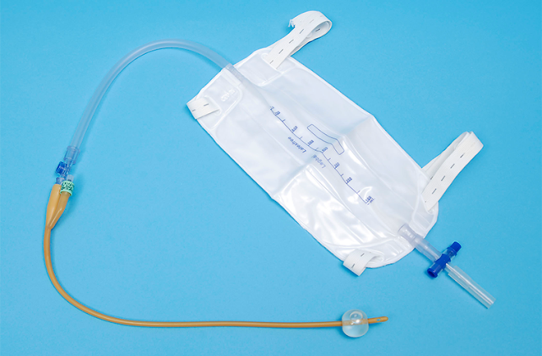

Slide 6
Epidemiology and mechanisms of CAUTIs
In low- and middle-income countries, the rate of CAUTIs is estimated at 8.8 per 1,000 urinary catheter days.
Patients in LMICs have twice the risk of developing CAUTIs compared to admitted patients in high income countries
In LMICs, CAUTIs are the second most frequent type of HAI (24% of all HAIs), second only to SSI.
The urinary system is normally sterile except for the end of the urethra.
The normal defenses against UTI are free flow of urine down the urethra and complete evacuation of the bladder.
Notes:
8.8 per 1,000 urinary catheters inserted per day
Stone, strictures etc… may obstruct urine flow. Reflux

Slide 7
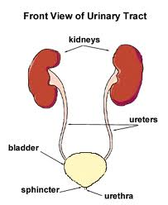

Slide 8
Mechanism
The insertion of a catheter could introduce microorganisms from the end of the perineum and urethra (endogenous infection)
Provides a pathway for organisms to reach the bladder, and is a foreign body on which biofilm can form.
The hands of health care workers during catheter insertion or manipulation of the collection system can also introduce microorganisms to the sterile parts of the urinary system (exogenous).
Notes:
Bacteria from rectum, anus, urethral opening could get introduced.
Need to strictly follow IPC procedures in order to avoid introduction of microorganisms.

Slide 9
Common pathogens
Escherichia coli, Pseudomonas spp., Klebsiella pneumoniae and organisms from the Enterobacter group.
Infections with fungi, such as the Candida species, have increased with the advent of HIV/AIDS.
A small proportion of CAUTI are caused by Staphylococcus spp.
Biofilm
Microorganisms form biofilms on most devices that are inserted or introduced into the body, including urinary catheters.
Biofilms may play an important role in the development of CAUTIs because bacteria within biofilms are protected from being penetrated and killed by antimicrobial agents and host defenses.

Slide 10
Risk Factors of CAUTI
Catheter-related factors
  Duration of catheterization
  poor insertion technique
  poor catheter care and
  failure to maintain a closed drainage system.
Notes:
Single most important risk factor of CAUTI
HIV patients, chronic diseases, steroid treatment, cancer patients
Women are more prone to CAUTI and UTI compared to men probably due to the difference in the anatomy of renal system

Slide 11
Cont..
Patient-related factors:
  Compromised immune system
  Diabetes mellitus
  Renal dysfunction

Slide 12
Catheter-Associated Urinary Tract Infection Prevention Strategies
Use urinary catheters appropriately: Insert a catheter only when indicated and remove it when no longer needed.
Keep the catheter secured to minimize bladder trauma.
Ensure recommended catheter maintenance practices.
Maintain a closed drainage system using aseptic technique.
Educate patients and families about preventing CAUTI.
Remove the catheter as soon as possible.
Notes:
The normal epithelium is a natural defense to infection. Trauma provides gateway for bacteria.

Slide 13
Acceptable indications for catheterization
For hemodynamically unstable patients that require accurate urinary output every 1–2 hours.
Acute urinary retention and obstruction
Assisting in healing open sacral or perineal wounds in incontinent patients
Prolonged immobilization due to trauma or surgery
Perioperative indications and prolonged surgeries such as monitoring urine output during certain types of surgery (e.g., fistula repair, pelvic organ prolapse surgery, cesarean section)
Notes:
Patients in shock (septic, hypovolemic or cardiogenic), fluid overload, acute kidney failure due to various causes etc…
Retention and obstruction: bladder trauma, stones, Prostitis, BPH, bladder tumor/cancer, paralysis due to trauma etc.
Incontinence: fistula, trauma, paralysis etc.

Slide 14
Alternative methods for limiting the use of indwelling catheters
Loss of control (incontinence) or inability to void (retention) may be managed better by straight (in-and-out) catheterization several times a day rather than by use of an indwelling catheter.
Regular toileting schedule or voiding on patient demand if ambulatory
Use of adult diaper pads, condom catheters
Bladder retraining to manage incontinence when coughing or sneezing
Medical management of incontinence
Notes:
Intermittent catheterization.
Medication (such as oxybutynin, tolterodine and trospium) can help residents with urinary incontinence but might also have side effects that could potentially worsen incontinence episodes.

Slide 15
General guidelines for proper catheter insertion techniques
Provide written guidelines for catheter insertion and educate HCWs on correct insertion technique.
Only properly trained persons (e.g., HCWs) who know the correct IPC techniques for catheter insertion perform catheter insertion.
Ensure that all supplies (for example, hand hygiene supplies, sterile gloves, drapes, antiseptic solution, syringes and sterile water, etc.) are available.
Follow IPC practices during insertion, removal, and replacement of indwelling catheters.
Consider using the smallest bore (diameter) catheter possible to minimize bladder neck and urethral trauma
Choose an indwelling catheter system with pre-connected, sealed catheter
Secure indwelling catheters properly after insertion, to prevent movement and pulling of the catheter within the urethra

Slide 16
Urinary catheter insertion procedure
Step 1: ensure the following items are available
A sterile indwelling urinary catheter with an attached closed continuous drainage system or sterile straight catheter and a clean urine collection container
A catheter with a diameter as small as possible to ensure good drainage.
A 10-mL syringe filled with sterile water for filling the balloon of the indwelling catheter
A pair of non-sterile gloves and a pair of sterile gloves
A sterile drape, ideally with an opening in the center
Either antiseptic solution (e.g., aqueous 10% povidone-iodine) if the patient has an iodine allergy or sterile solution for periurethral cleaning (e.g. normal saline)

Slide 17
Cont…
Sterile, sponge-holding forceps with sterile gauze squares (2 x 2) or large, cotton applicators
A single-use packet of lubricant (sterile, if possible)
Supplies to secure the catheter once inserted (adhesive tape)
A light source (flashlight or lamp), if needed
A basin of clean, warm water, soap, and a clean, dry towel
A waterproof polyethylene sheet
A plastic bag or leak-proof, covered waste container for disposal of contaminated items
Notes:
To avoid friction and trauma during insertion of the catheter, for easy insertion.

Slide 18
Insertion…
STEP 2: Explain the procedure to the patient and gain verbal consent. Answer any questions that the patient may have.
STEP 3: Ensure that a good light source is available.
STEP 4: Prior to starting the procedure:
Have female patients separate their labia and gently wash the urethral area and inner labia with soap and water, if they are able to.
Have male patients who have not been circumcised retract their foreskin and gently wash the head of the penis and foreskin with soap and water, if they are able to.
Notes:
Privacy issue, compassion, communication, creating a sense of closeness to improve cooperation during procedure.
Assist the patient in washing if they are un able to do so. Use non sterile glove and perform hand washing after assistance.

Slide 19
Insertion….
STEP 5: Assist the patient into the supine position with knees bent, hips flexed, and feet resting apart and place the waterproof polyethylene sheet beneath the patient.
Step 6: Perform hand hygiene.
Step 7: Put non-sterile gloves on both hands.
Step 8: Cover both thighs with a sterile drape with the opening in the drape revealing the area around the urethral opening.
Step 9: For HCWs who are right-handed (dominant hand), stand on the patient’s right side (or on the left side if left-handed).

Slide 20
Insertion…
Step 10a: For female patients, separate and hold the labia apart with the non-dominant hand to expose the urethral opening.
Apply antiseptic by moving from above, downward on one side, and then discarding the swab. Repeat on the other side, and lastly apply antiseptic at the center to clean the urethral opening.
Step 10b: For male patients, push back the foreskin for men who have not been circumcised, and hold the head of the penis with the non-dominant hand.
Apply antiseptic in a circular fashion, moving away from the urethral opening. Apply antiseptic solution two times.

Slide 21
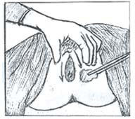
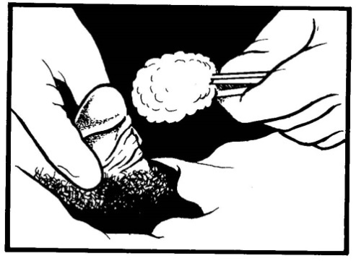
Cleaning Female and Male Genital Areas before Insertion of an Indwelling Catheter
Note: Wipe down one side of the urinary meatus, and discard the wipe. Using a sterile wipe, repeat on the opposite side of the urinary meatus, discard the wipe, and lastly, clean down the center.
Note: Clean the penis in a circular motion, starting at the tip of the penis and moving downward. Discard the wipe and repeat the cleaning with a new, sterile wipe.

Slide 22
Insertion…
STEP 11: Remove gloves.
STEP 12: Perform hand hygiene and put on sterile gloves.
STEP 13: If inserting a straight catheter, grasp the catheter about 5 cm (2 inches) from the catheter tip with the dominant hand and place the other end in the urine collection container.
STEP 14a: For women, apply lubricant jelly on the outer surface of the catheter and gently insert it about 5–8 cm or until urine flows. For children, insert only about 3 cm.

Slide 23
Insertion…
STEP 14b: For men, apply lubricant jelly on the outer surface of the catheter. Using the non-dominant hand, hold the penis with slight upward tension and perpendicular to the patient’s body
Gently insert the lubricated catheter with the dominant hand about 18–22 cm, lower the penis 90 degrees toward the patient’s toes, advance the catheter a little more, and rotate the catheter until urine flows. For children, insert only about 5–8 cm.

Slide 24
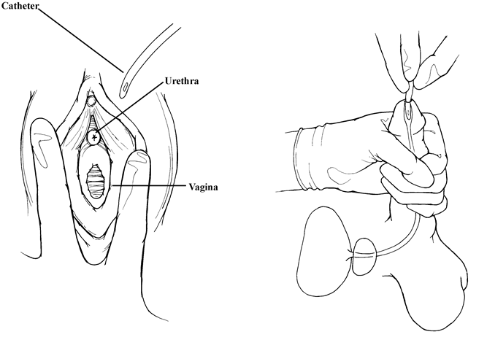
Catheterization Techniques for Female and Male Patients

Slide 25
Insertion…
STEP 15: If inserting an indwelling catheter, push another 5 cm after urine appears and have another trained HCW wearing sterile gloves connect the catheter to the urine collection tubing if not using a closed system. Always ensure that urine is flowing before filling the balloon.
STEP 16:
For an indwelling catheter, fill the balloon as per the manufacturer’s instructions and pull out gently to feel resistance.
For straight (in-and-out) catheterization, allow the urine to drain slowly into the collection container and then gently remove the catheter.
STEP 17: Secure the catheter to the patient’s thigh (for women) or lower abdomen (for men)

Slide 26
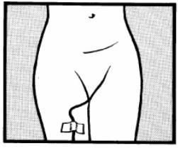
Securing a Female Indwelling Catheter
Notes:
Adhesive tape

Slide 27
Insertion…
STEP 18: Place soiled items, including the straight catheter, in a plastic bag or leak-proof, covered container for contaminated waste.
STEP 19: Ensure that the patient is left dry and comfortable.
STEP 20: Remove gloves and place them in a plastic bag or container for contaminated waste.
STEP 21: Perform hand hygiene.

Slide 28
Removal or Replacement of a Urinary Catheter
STEP 1: Make sure that all items are available if replacing an indwelling catheter, including:
A pair of non-sterile gloves (if replacing the catheter, a pair of sterile gloves will be needed as well)
A sterile syringe for removing fluid from the catheter balloon
Sponge forceps with gauze squares (2 inches x 2 inches) or large, cotton applicators
A plastic bag for contaminated waste or a leak-proof, covered waste container for disposal of contaminated items

Slide 29
Removal or replacement….
STEP 2: Have the patient wash the urethral area (women) or the head of the penis (men) with soap and water, or do this step for them. Perform hand hygiene and wear a pair of non-sterile gloves. Remove and dispose of the gloves after cleaning.
STEP 3: Perform hand hygiene
STEP 4: Put gloves on both hands; non-sterile gloves for removal, sterile gloves for replacement.
STEP 5: With a syringe, remove the water from the catheter balloon.

Slide 30
Removal or replacement…
STEP 6a: For women, separate and hold the labia apart with the non-dominant hand; using cotton applicators or a gauze swab held with forceps, clean the urethral opening and area around it with an antiseptic solution.
STEP 6b: For men, push back the foreskin for those who have not been circumcised, and hold the head of the penis with the non-dominant hand..

Slide 31
Removal or replacement…
STEP 7: If you are just removing the catheter, follow Steps 18 through 21 of the Insertion Procedure.
STEP 8: If you are replacing the indwelling catheter, follow Steps 4 through 21 of the Insertion Procedure.

Slide 32
Recommended Catheter Maintenance Practices
Educate HCWs on the insertion, care, and maintenance of urinary catheters and about prevention of CAUTIs.
Always follow Standard Precautions to protect against contact with blood or body fluids, including wearing gloves and other personal protective equipment (PPE) (face shield, goggles, plastic apron) if there is a risk of splashing, during any manipulation of the catheter or collection system.
Perform hand hygiene immediately before and after any handling of the urinary catheter, insertion site, or collection set
Check the flow of urine through the catheter several times a day to ensure that the catheter is not blocked.

Slide 33
Recommended….
Maintain catheter securement to the patient’s leg or abdomen to prevent movement and pulling.
Cleanse the perineal area daily with soap and water during routine bathing while the catheter is in place
Wash the head of the penis and urethral opening (men) or the tissue around the urethral opening (women), the perineal area, buttocks, and any area that is soiled after a bowel movement or if the patient is incontinent.

Slide 34
Avoid the following practices for catheter maintenance:
Avoid disconnecting the catheter from the drainage tubing (unless deemed medically necessary). Change the urinary catheter if the closed system is disconnected.
Do not clean the perineum area with antiseptics while the catheter is in place. Routine hygiene (e.g., cleansing of the meatal surface [opening of the urethra] during daily bathing or showering with soap and water) is appropriate.
Do not treat asymptomatic bacteriuria in catheterized patients except before invasive urologic procedures.
Do not perform continuous irrigation of the bladder with antimicrobials as a routine IPC measure. If continuous irrigation is being used to prevent obstruction, maintain a closed system.

Slide 35
Avoid….
Do not use systemic antimicrobial rOutinely as prophylaxis (a preventive treatment) either for short- or long-term catheterization unless there are clinical indications (e.g., bacteriuria upon catheter removal post-urologic surgery).
Do not change catheters or drainage bags at routine, fixed intervals. Rather, change catheters and drainage bags based on clinical indications such as infection, obstruction, or when the closed system is compromised.
Do not use antibiotic-coated catheters.
Do not use routine instillation of antiseptic or antimicrobial solutions into urinary drainage bags:
Do not re-use catheters between patients; biofilm develops in the lumen, which is narrow and difficult to reprocess adequately.

Slide 36
Cont..
The CAUTI prevention practice bundle consists of the following interventions:
Insertion of catheters only when indicated and removal of catheters when they are not medically necessary.
Consideration of alternatives for urinary output management, including condom catheters and in-and-out catheterization, when appropriate.
Hand hygiene before insertion and manipulation of catheters.

Slide 37
Summary
Health care workers can prevent CAUTIs by limiting use of indwelling urinary catheters, daily reviews of indications for continuation of indwelling catheters, and stringently applying the IPC practices recommended in this chapter for insertion, maintenance, and removal. Applying recommendations of the CAUTI prevention bundle will also help avoid infections

